Slide 1
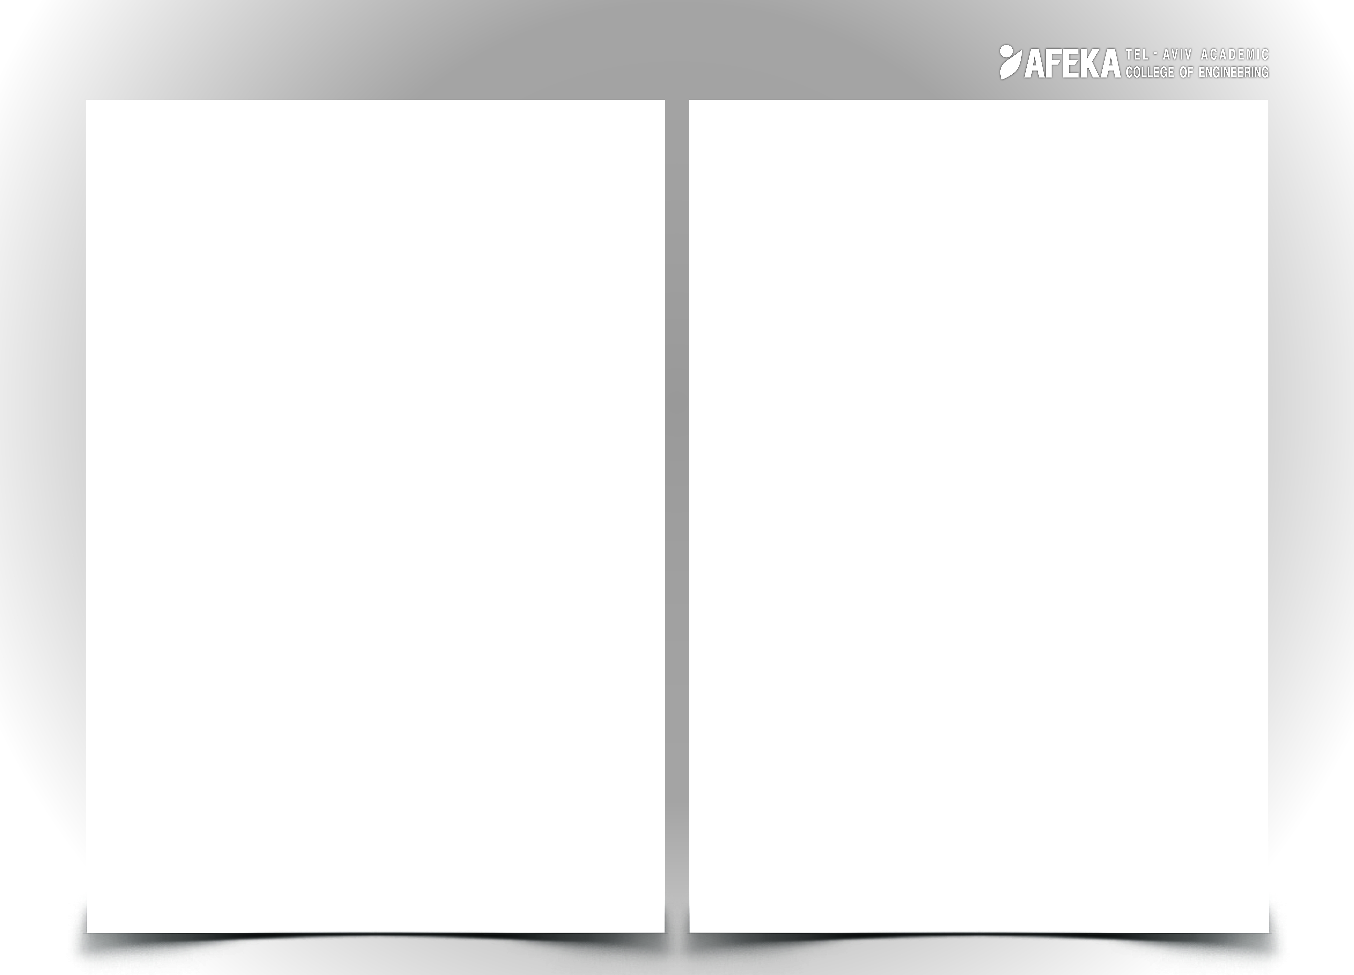
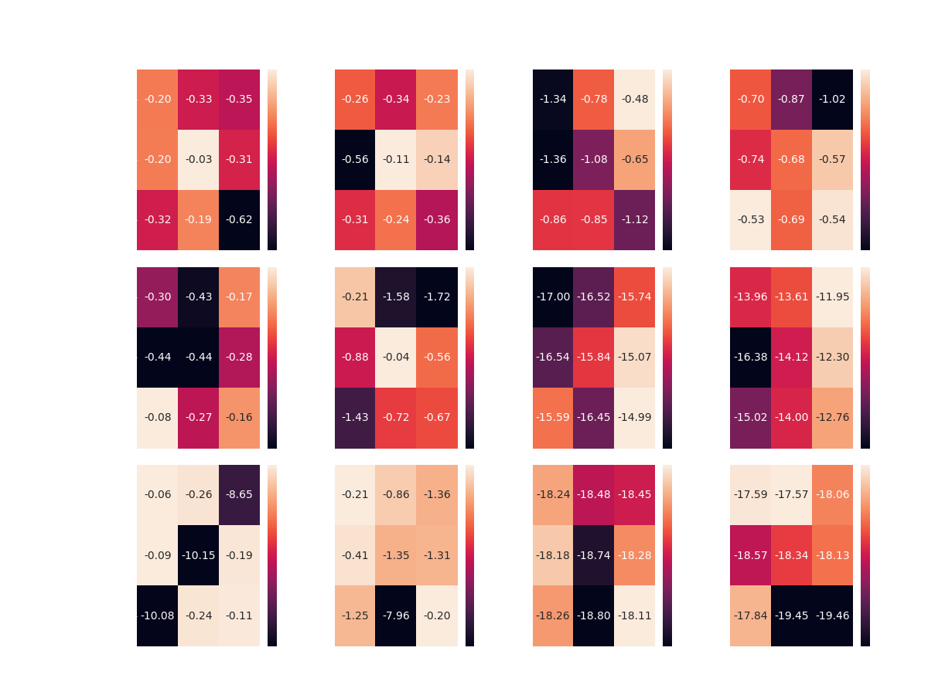
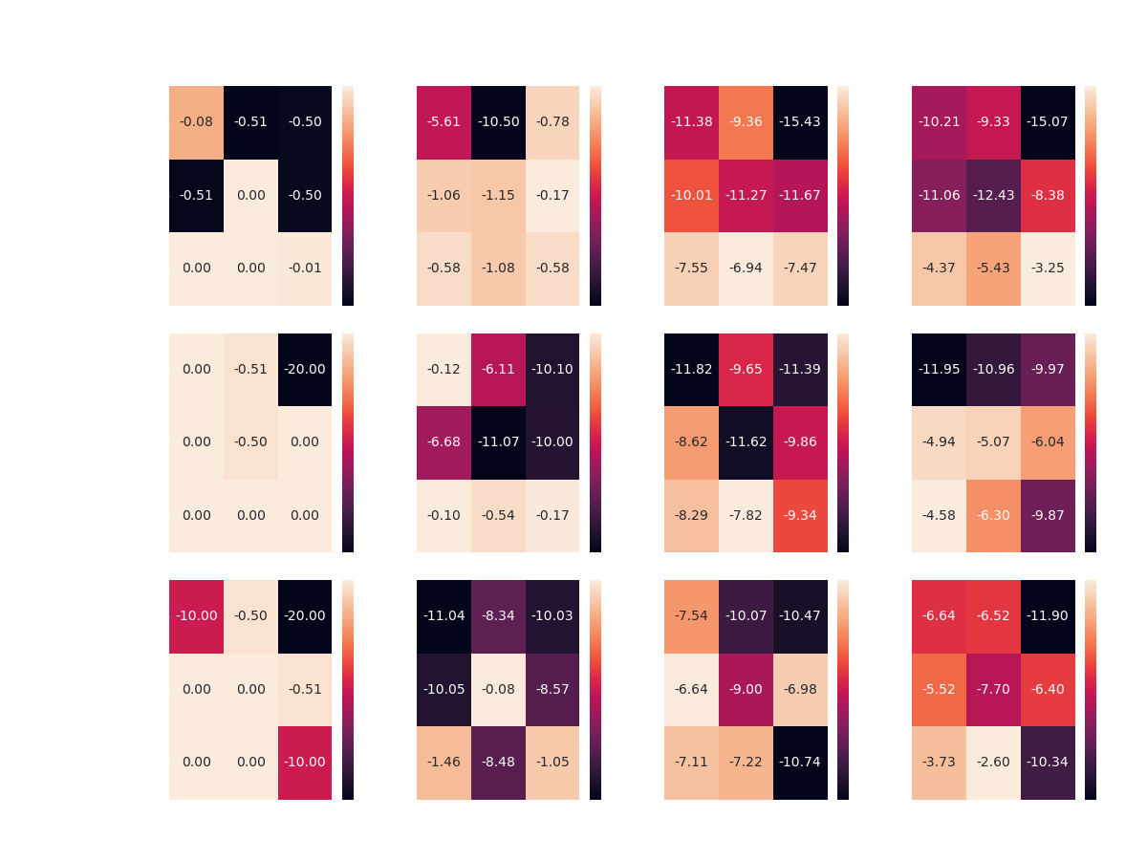
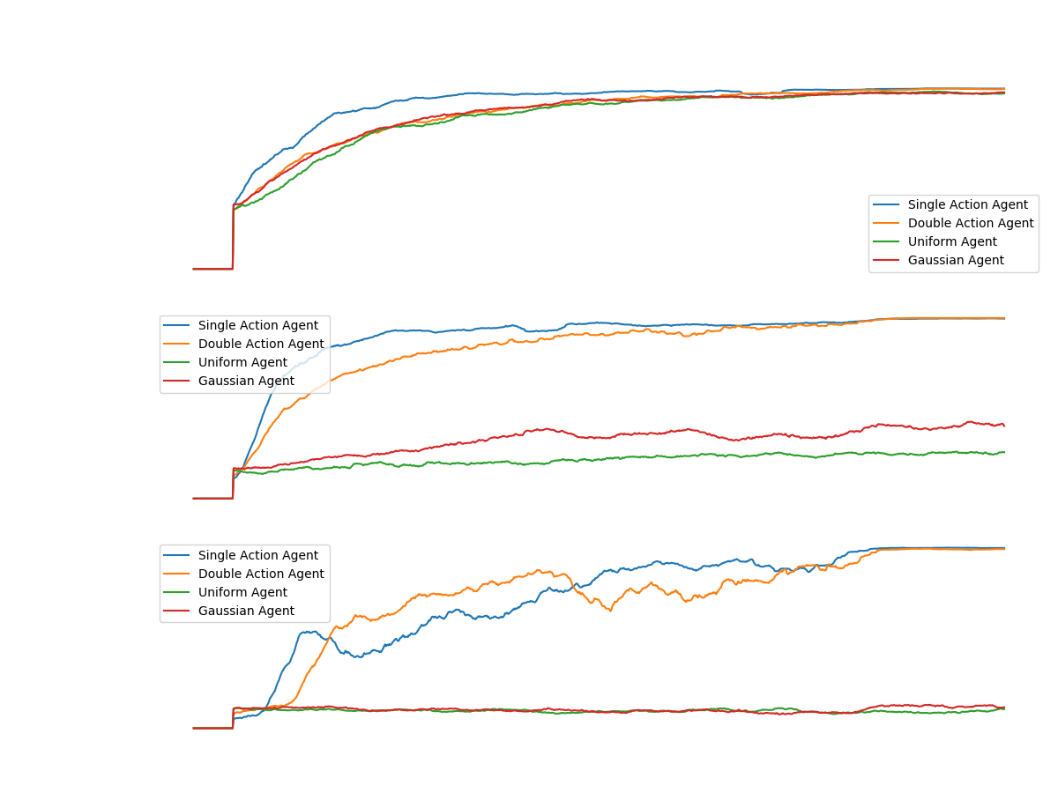
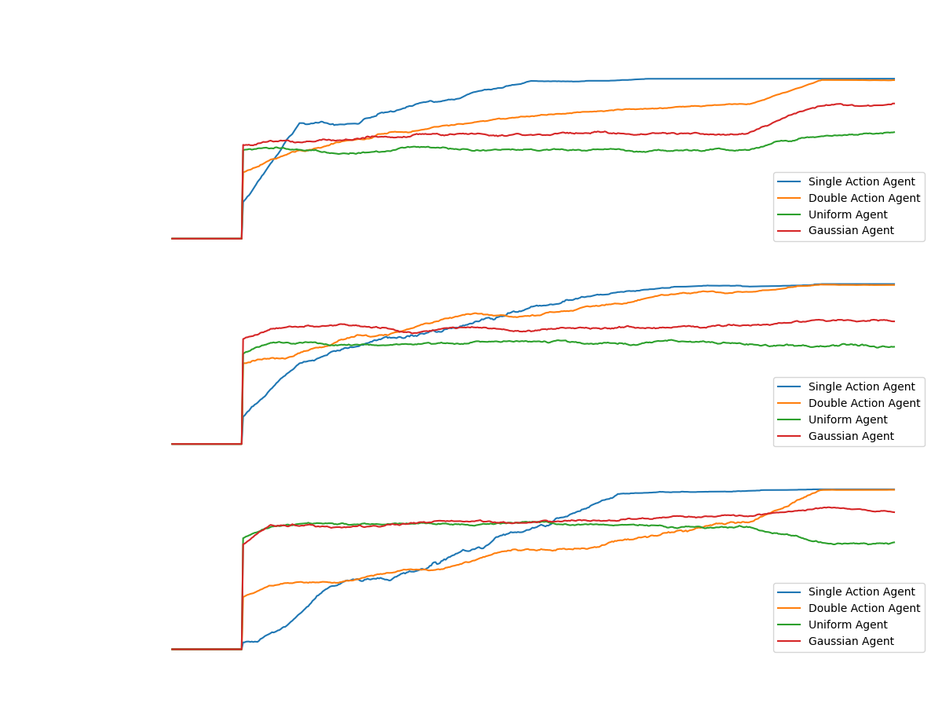
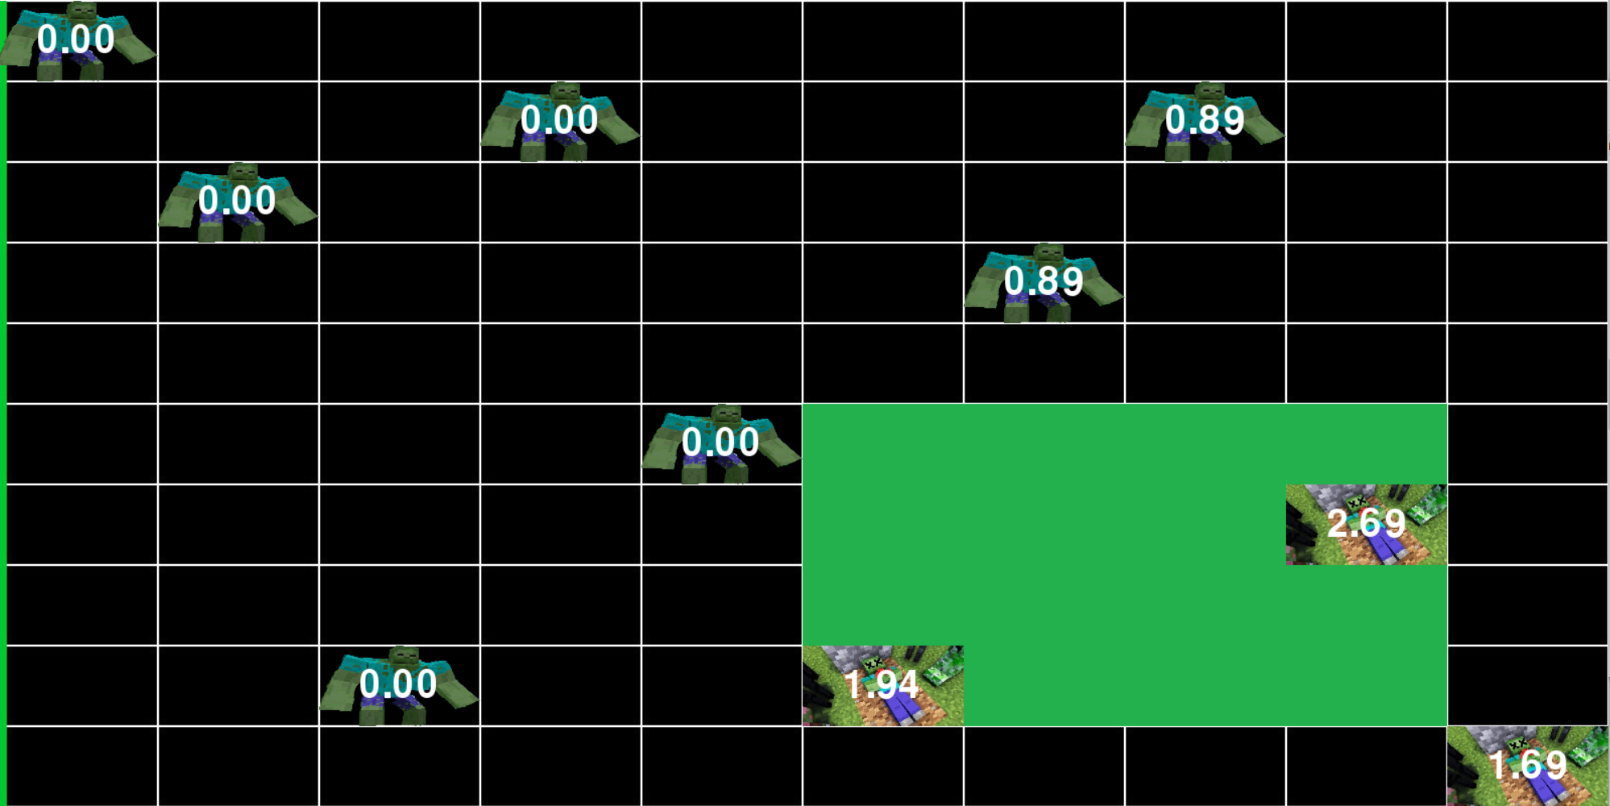
Eliav Shalelashvili
Advisor: Dr Yehudit Aperstein
Intelligent Systems
Mastering a zero-sum asymmetric game using deep neural network
Methodology
As part of the project, we conducted a literature review of similar problems and different ways to solve them, a review that formulated our path to action. Which is, the implementation of a basic algorithm from the field of RL, called Double Deep Q-Network (DDQN), another algorithm from the field of general computer science search methods called Monte Carlo Tree Search (MCTS) and finally a state-of-the-art algorithm called AlphaZero.
The learning agents were tested on a variety of games (different board sizes) and in different configurations (hyper-parameter optimization). At first, we tested the learning agents against a group of simple agents with a constant or random strategy. Then conducted a competition between the learning agents: DDQN and AlphaZero.
Results
The DDQN and AlphaZero based agents achieved convergence in a variety of scenarios tested and in contrast the MCTS algorithm did not converge at all due to RAM limitations of the machine.
The Competition
After we have trained our two learning agents: DDQN and AlphaZero to the best we could, in every game board and on each side of it. We examined the success of the agents against each other. This competition has led to a significant victory for DDQN in most heats, this victory is not intuitive and did not come as expected but can be explained by the massive amount of AlphaZero parameters in relation to DDQN and by the insufficient number of episodes we ran during training due to long run time of the implementation we chose.
In this research we are dealing with solutions of a two-player zero-sum game with asymmetric information. The goal of each player is to maximize its reward. The game is a civilian version of a known security problem. We formulate the problem as a problem in the field of Reinforcement Learning (RL) and we will examine problems and solutions from there.
The Game
Imagine a board of zombies approaching from some locations in the left side of the board towards the right side of the board. Above all that, there is a light that can be positioned anywhere on the board. The two agents will be called 'Zombie Player' and 'Light Player' the Zombie Player is responsible of positioning the zombies in the left side and determine their initial angle and speed that will stay constant for each zombie. On the other hand, the Light Player decides where to project his light in every turn. Each zombie that leaves the left side of the board and goes under the light of the Light Player is damaged and his strength meter is lowered by some value. In general, the goal of the Zombie Player/Light Player is to maximize/minimize the strength of the zombies that are reaching the right side of the board.
The Framework
We built the framework on which we ran and taught the learning algorithms in a way that would be generic and configurable for multiple runs of learning agents for the use of researchers who are dealing with similar problems.

